Slide 1
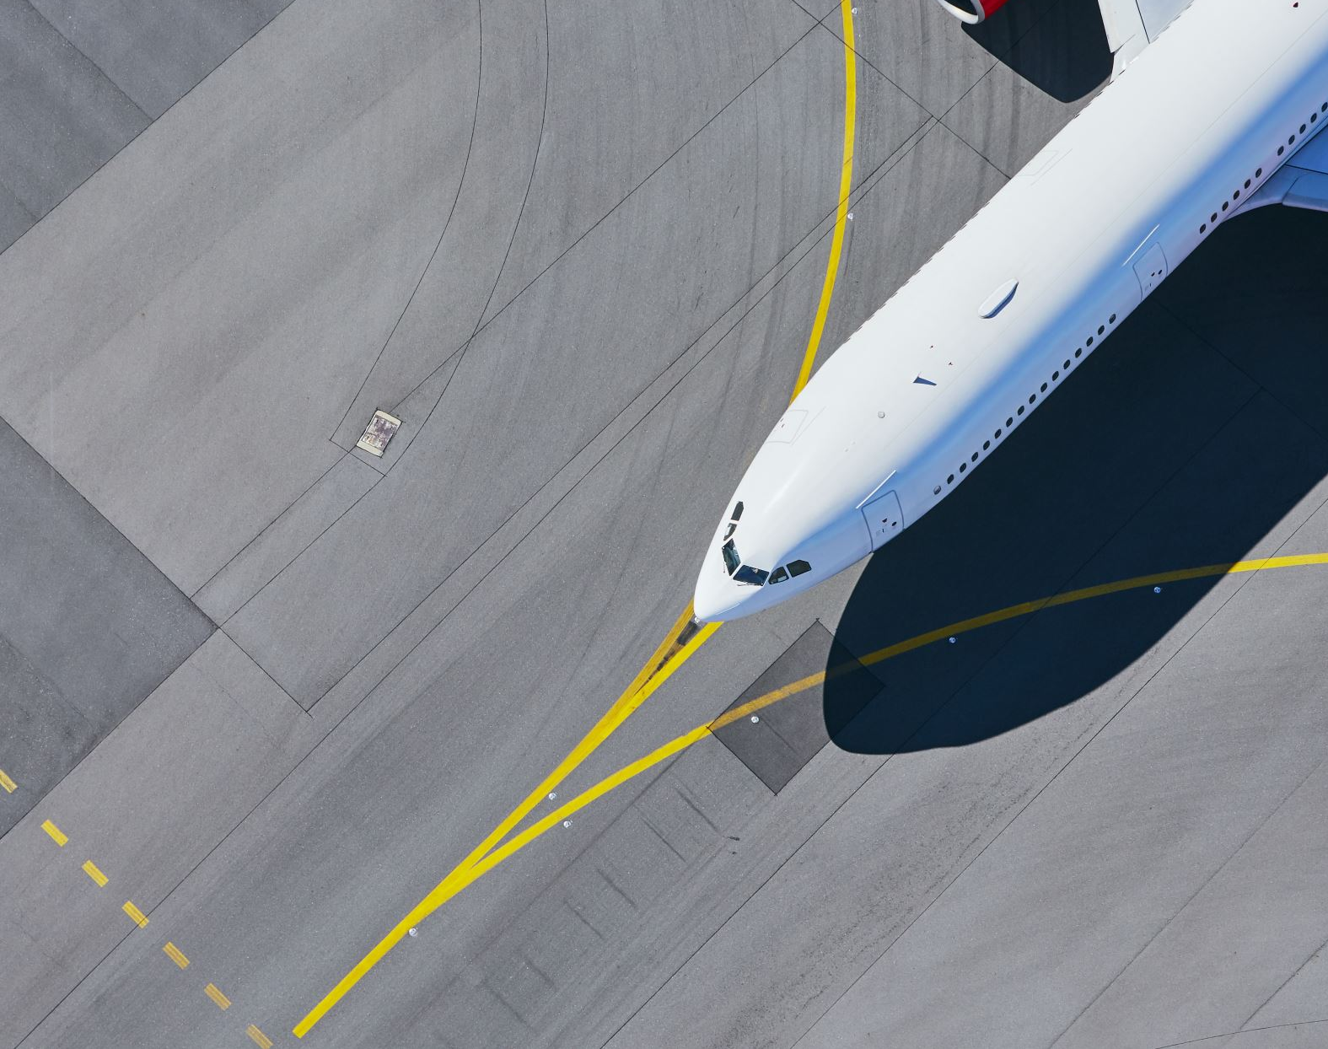
Tourism Recommender System
By
Yusri Al-Sanaani
Hetvi Soni
Tavleen Kour
Immanuella Iyawe
Group: DSA_202101_ 7
Professor: Arya Rahgozar

Slide 2
Outlines
Introduction
Data Preperation
Recommender system methodologies
Chatbot implementation and demo
Summary
Results
Error Analysis
Insights

Slide 3
Problem Statement
Implement a recommendation system based on content and collaborative filtering, leveraging many algorithms to provide different prediction features such as providing recommendations based on:
Attraction type
Targeted province
The best time to visit the attraction
Multiple combined features
Resulting with multi functional recommender system that based on content, context and ratings.
Choosing the best performing model and implemented a chatbot for it. Therefore, the recommender system turned out to be very useful and convenient to use for the tourists.

Slide 4
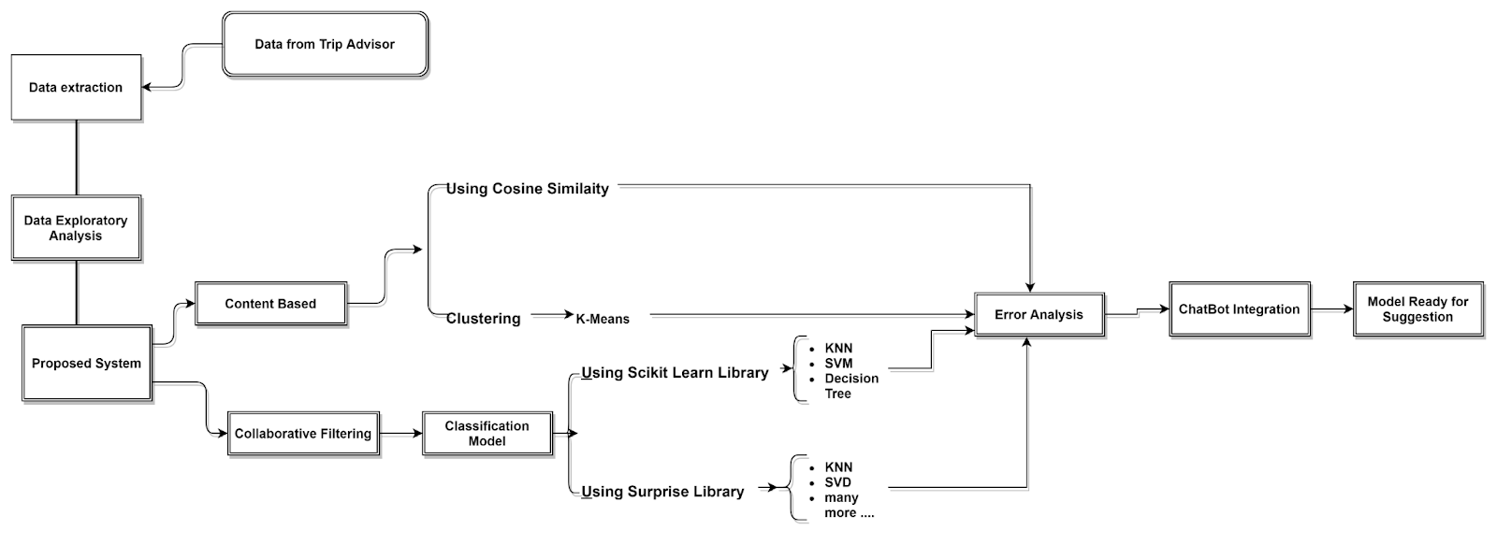
Methodology
Models Created:
Content based model based on:
The type of location.
The province of location.
The best time to visit.
Multiple combined features.
K-means clustering algorithm for unsupervised learning.
Collaborative filtering model based on:
Multiple classification algorithms in Scikit-learn Library for supervised learning.
Multiple algorithms in Surprise Library

Slide 5
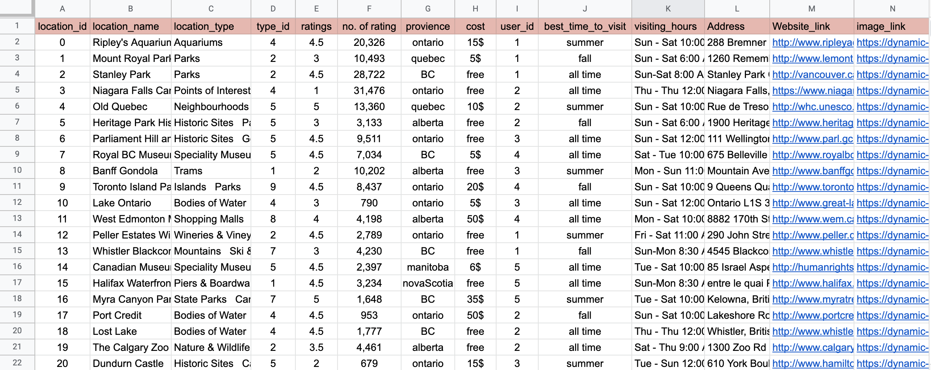
Data Perpetration
We scrapped the trip advisor website and then added modifications to it to get the desired dataset as per our requirements. TripAdvisor Website Link: https://www.tripadvisor.in/Attractions-g153339-Activities-Canada.html

Slide 6
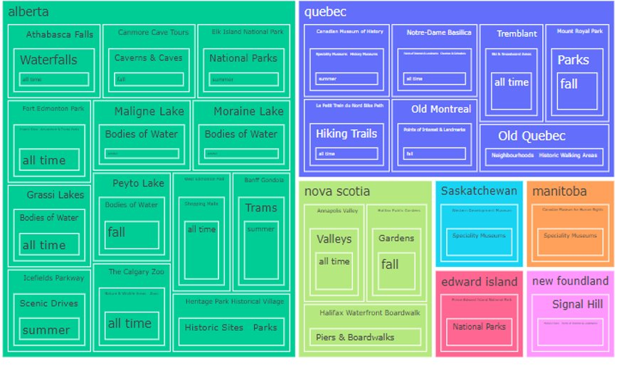
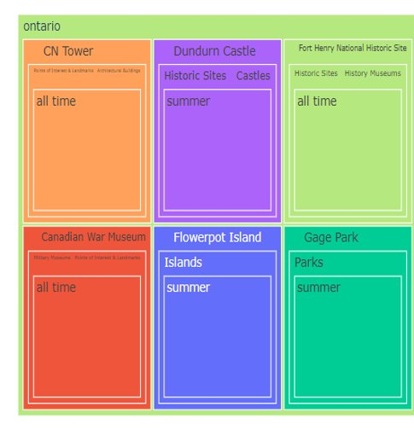
Exploratory Data Analysis
Visualization for tourist locations based on the province.

Slide 7
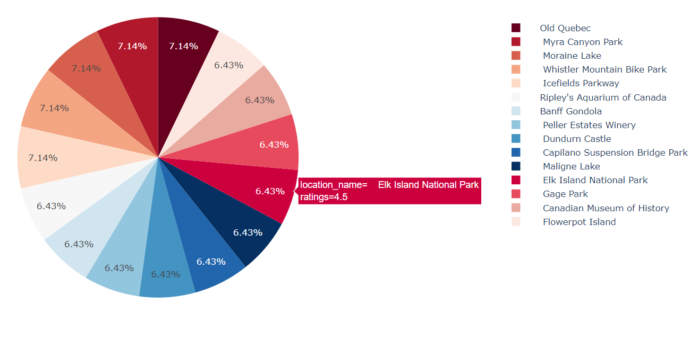
Exploratory Data Analysis
Visualization for best time to visit places in summer along with its ratings

Slide 8
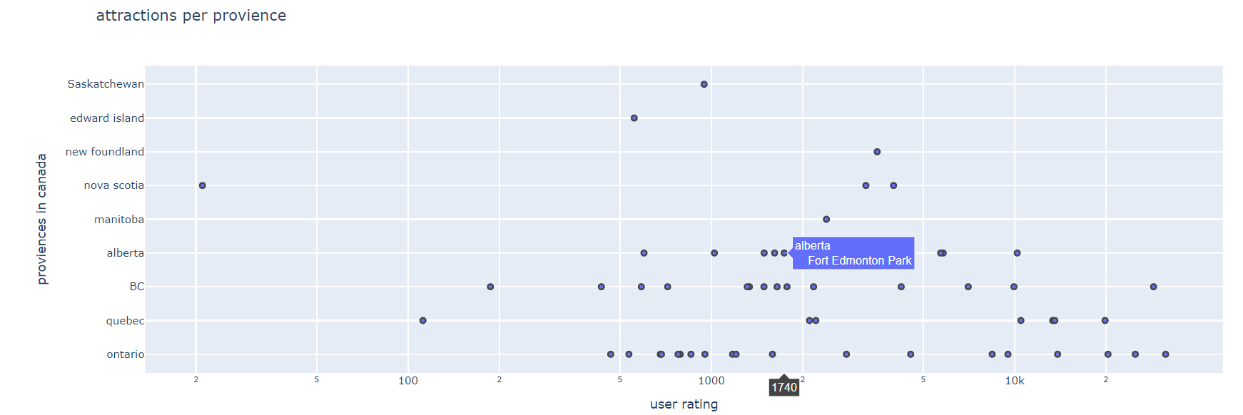
Exploratory Data Analysis
Visualization for number of user ratings per province

Slide 9
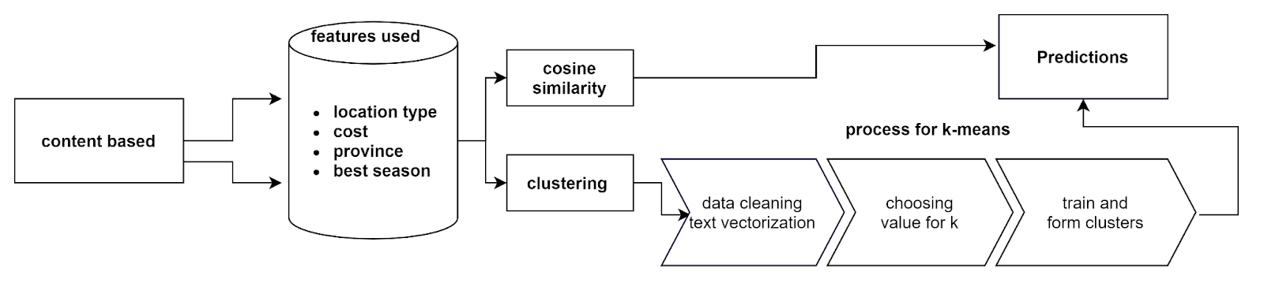
Content Based Filtering (CBF)

Slide 10
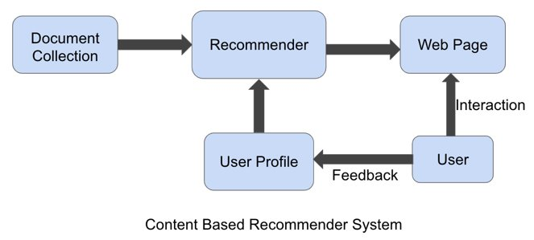
CBF Using Cosine Similarity
We created the following models based on cosine similarity:
Location Type
Province
Best time to visit
Combined features where feature are location_type, provience, cost, best_time_to_visit, ratings

Slide 11
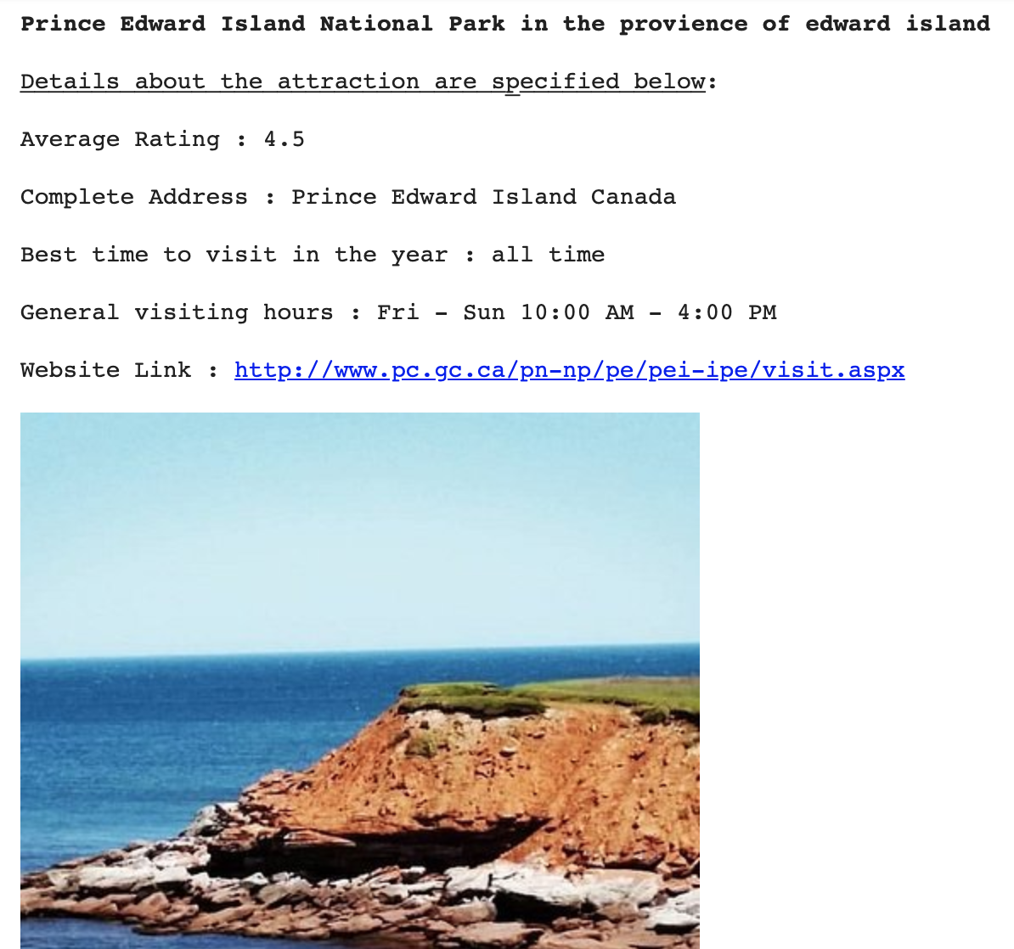
CBF Using Cosine Similarity
Results sample for content-based model for combined features.

Slide 12
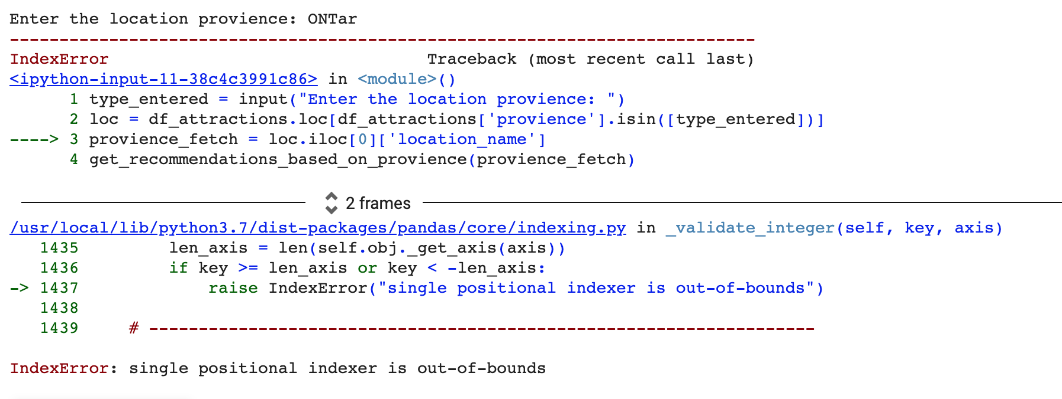
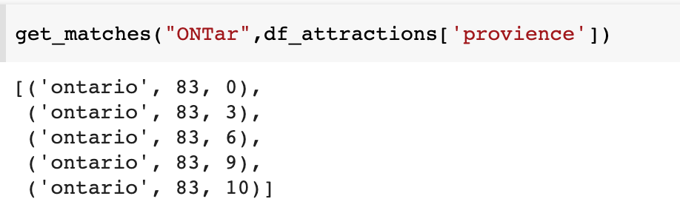
CBF Using Cosine Similarity - Error Analysis
The model is unable to predict when the string entered in not an exact match.
Libraries such as fuzzy wuzzy can be a work-around for such cases.
We could not enhance the code with it due to time limitation.
Fuzzywuzzy results

Slide 13
CBF Using Clustering
Get Clusters
Preprocess
Data
KMeans
Model
TF-iDF
Test Predict
Elbow Method
Cluster Predict
Recommend

Slide 14
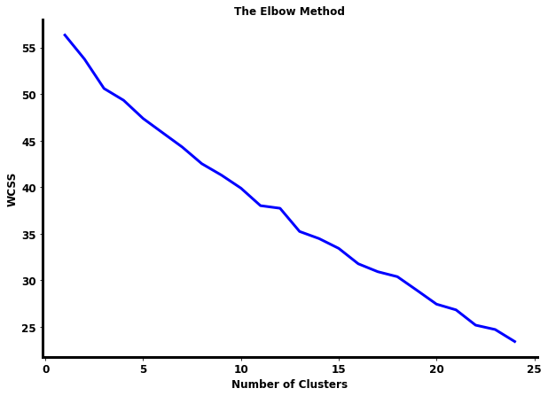
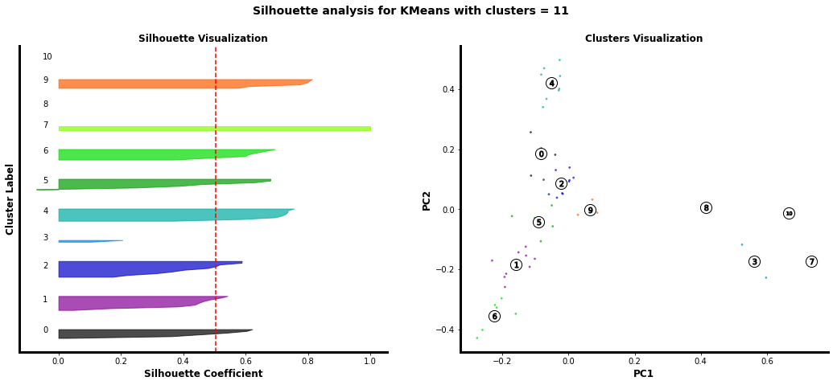
CBF Using Clustering
Using Silhouette Score: clusters = 11 gives the highest silhouette score value over (10,14,16)

Slide 15
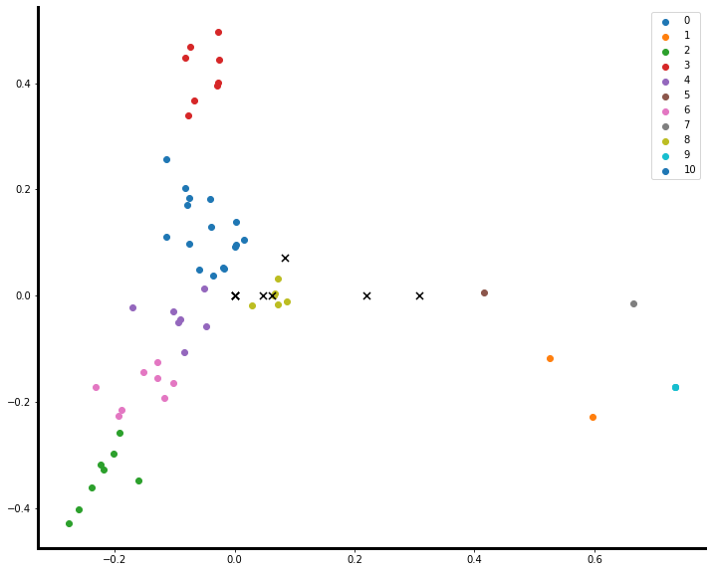
CBF Using Clustering

Slide 16
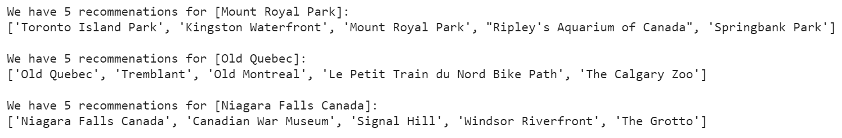
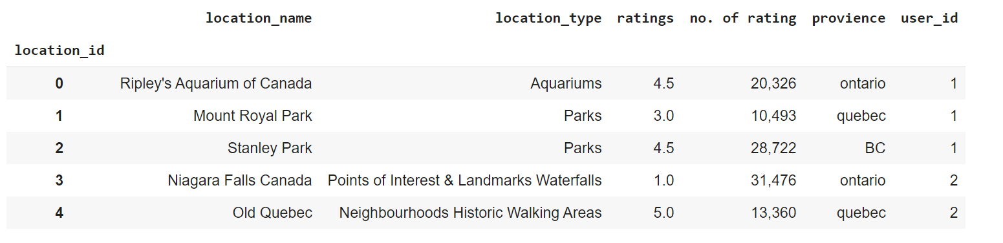
CBF Using Clustering
Results Sample
Error Analysis

Slide 17
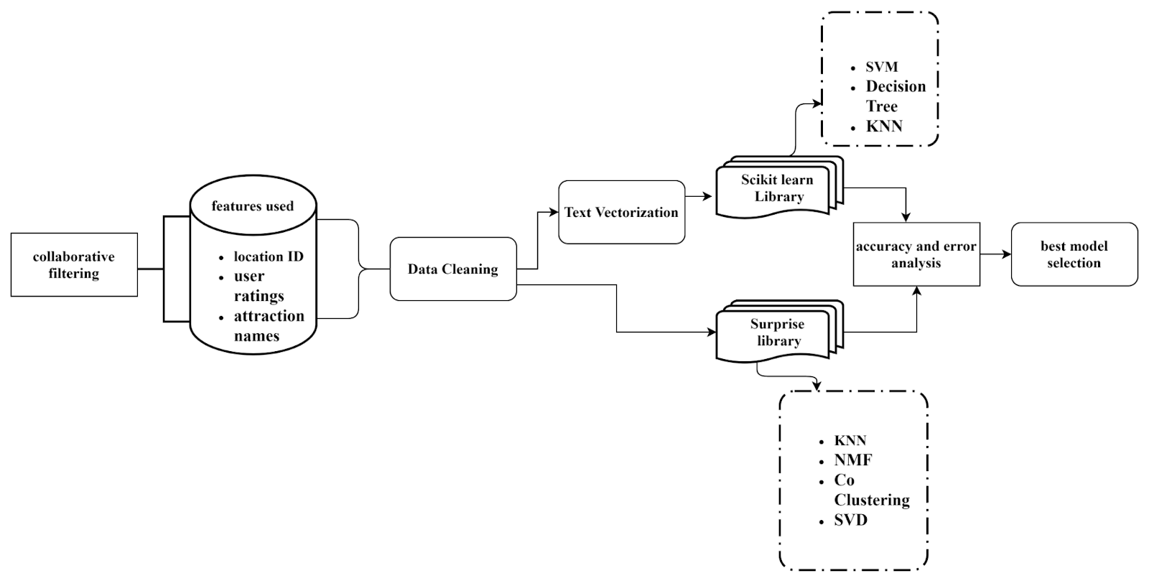
Collaborative Filtering (CF)

Slide 18
CF Using Scikit Learn Library
We performed classification for two cases:
Model 1: Using user id as labels
Model 2: Using Location type id as labels
We choose model 2 as our model since it shows better results.
Algorithms used are:
SVM, KNN and Decision Tree (Supervised learning)
Champion Model:
SVM

Slide 19
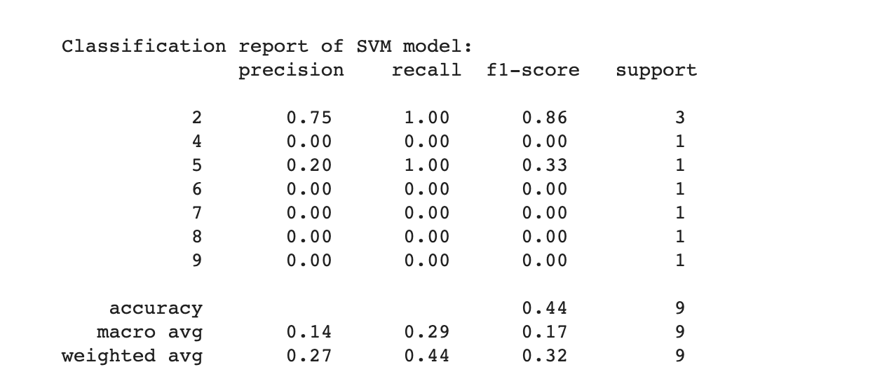
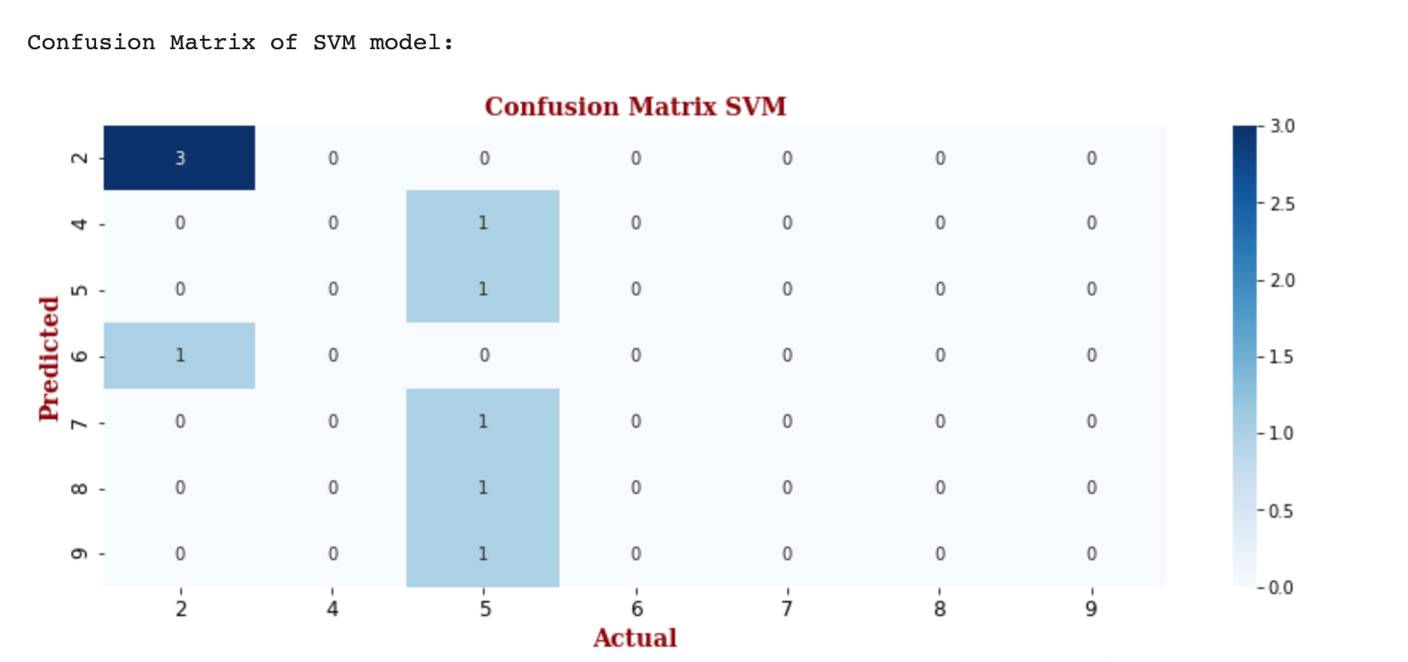
CF Using Scikit Learn Library
SVM model Evaluation
Classification Report
Confusion Matrix

Slide 20
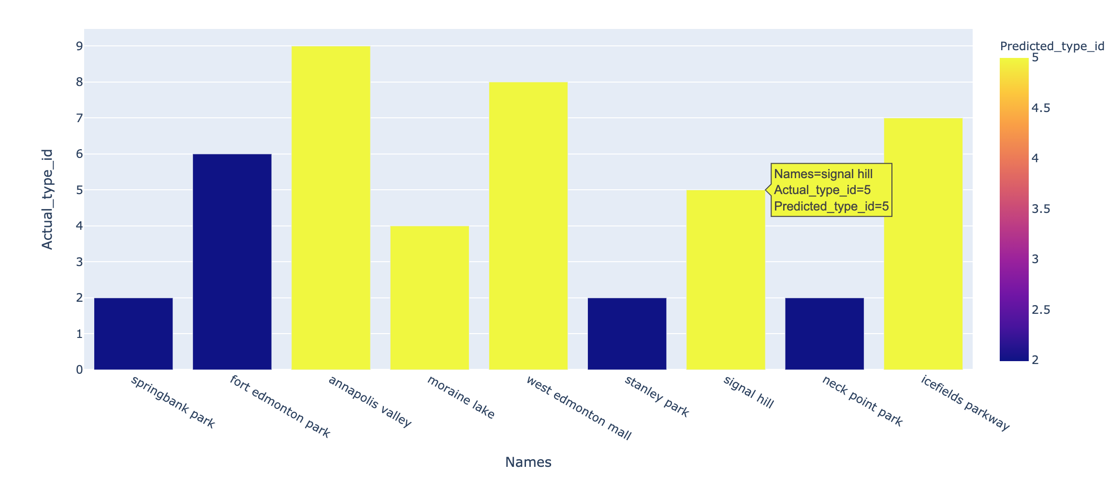
CF Using Scikit Learn Library
Visualization of predicted results

Slide 21
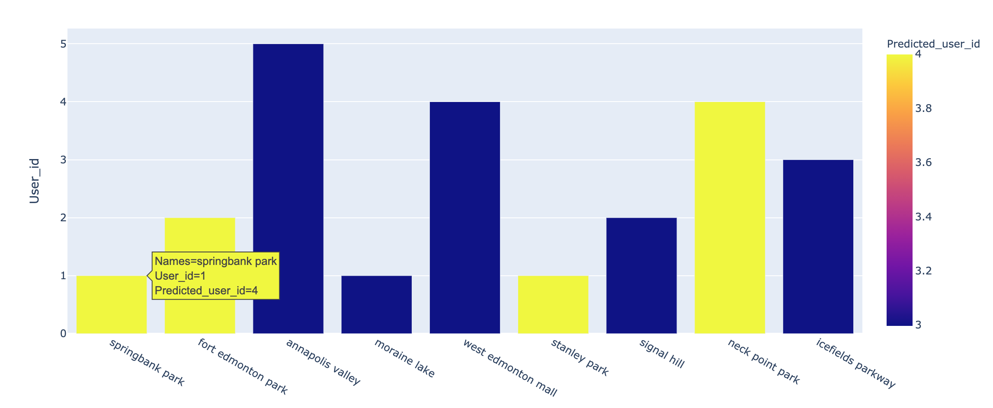
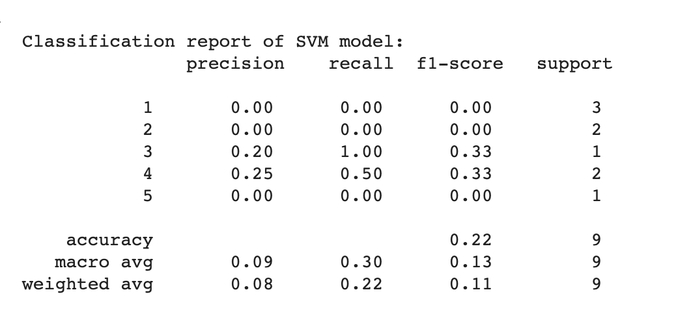
CF Using Scikit Learn Library - Error Analysis
SVM Model has poor results when user_ids is considered as labels with 22% accuracy.
Considering these results, we analysed the dataset and shifted the labels to location ID instead which enhanced the results to 44%
The results are still not very high, one of the major reason for this can be a smaller number of rows in our dataset. We need thousands of rows of training data to train the model well.

Slide 22
CF Using Surprise Library
Data
Ratings Extraction
Surprise Algorithms
Cross Validation
Performance Evaluation
Test And Analyze
Recommender System
Analysis of Collaborative Filtering
Best Model Selection
GridSearch Optimisation

Slide 23
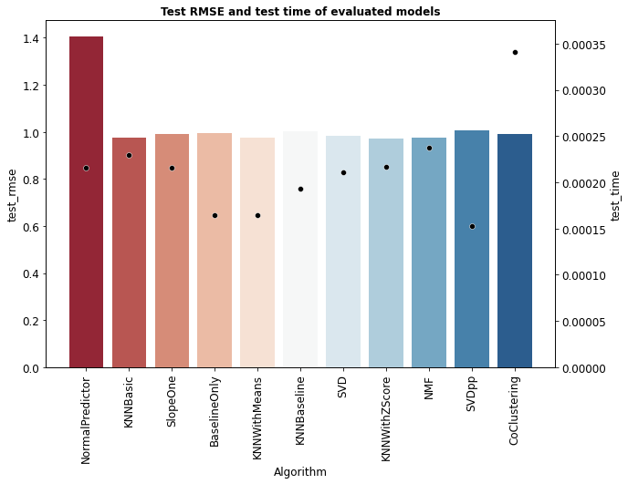
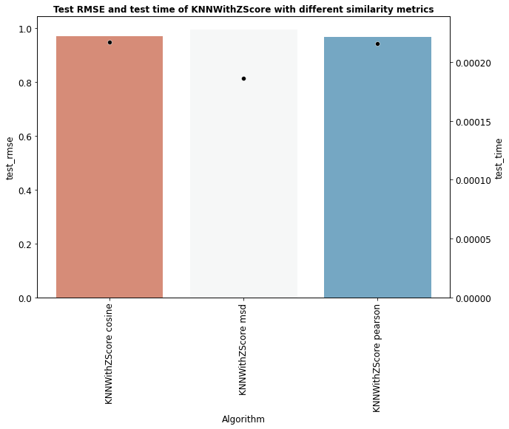
CF Using Surprise Library
The comparison of these models shows that:
KNNWithZScore algorithm gives the best performance with lowest RMSE error.
Performed Grid Search Cross Validation:
Pearson similarity metric
k = 40, min_k = 1 min_support = 1

Slide 24
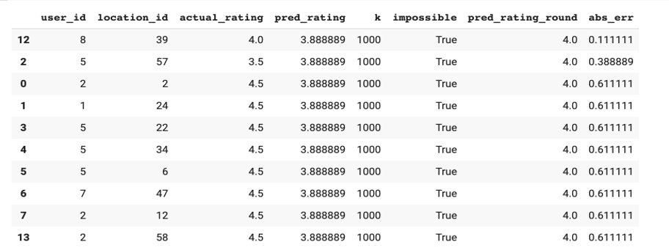
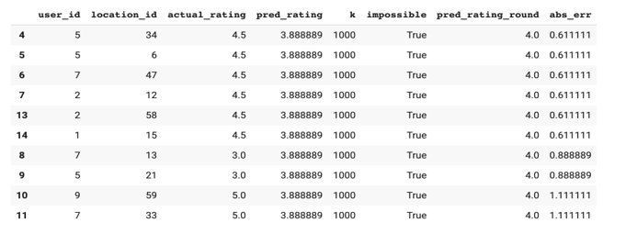
CF Using Surprise Library - Predictions
Best Predictions:
Worst Predictions:

Slide 25
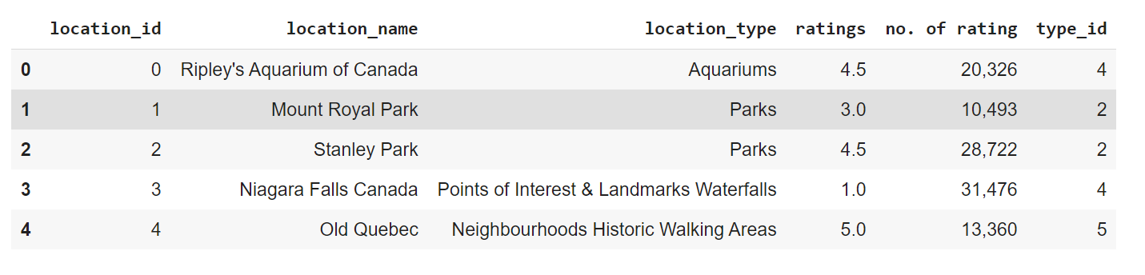
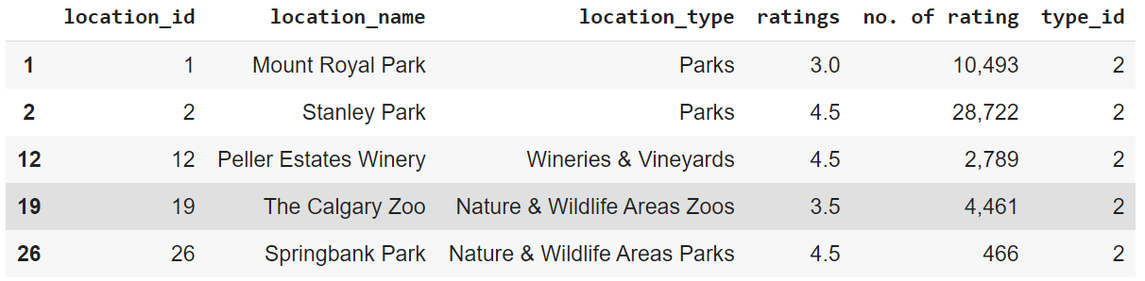
CF Using Surprise Library - Predictions

Slide 26
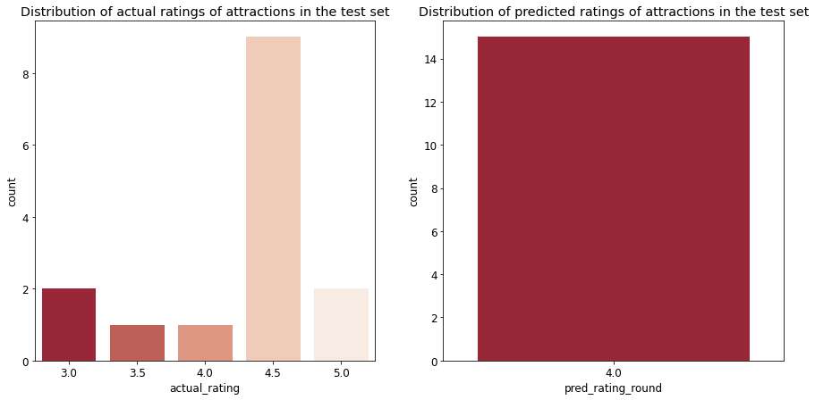
CF Using Surprise Library - Error Analysis

Slide 27
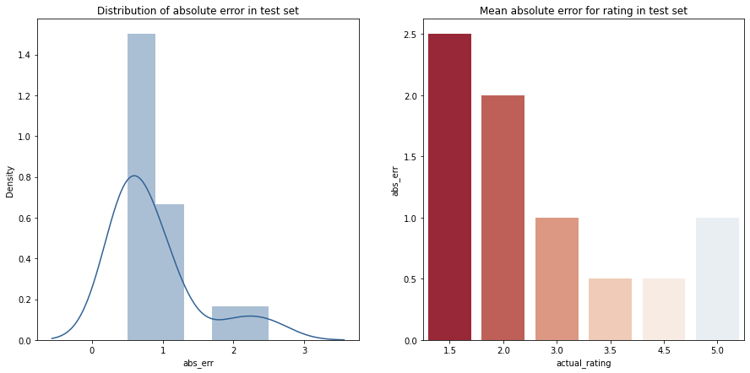
CF Using Surprise Library - Error Analysis

Slide 28
Chatbot Implementation
Recommender System
Flask
ChatBot
ngrok

Slide 29
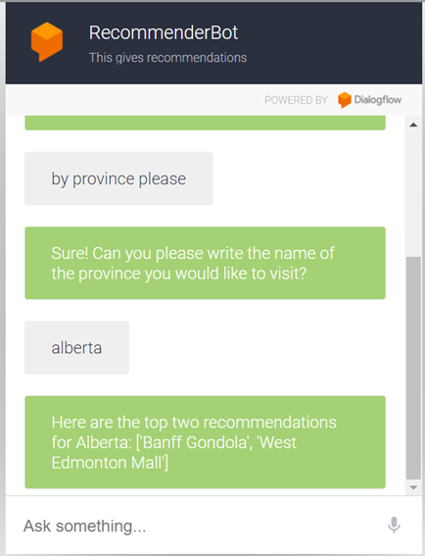
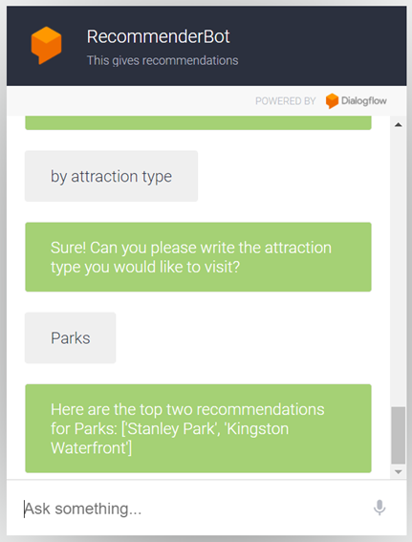
Chatbot Implementation
Recommendation based on Providence:
Recommendation based on Location type:

Slide 30
Summary & Insights
There are numerous ways to create recommender systems which performs well. The champion model depends on the requirements of the developer.
We analyzed the results and considered the error analysis and concluded that Content Based Model using Cosine similarity is our champion model.
After choosing the champion model ,we designed our chatbot system using this model and results achieved for the same are satisfactory.
Implementation of Chatbot involved some deep research work and new techniques and therefore proved to be very challenging.
Web scraping proved to be beneficial to get the required dataset from TripAdvisor.
Classification algorithms performs poorly due to inadequate data.
The dataset scrapped from the website further needed some improvisations to make it ideal for our use case.

Slide 31

Open for questions
THANK YOU!

